Slide 1
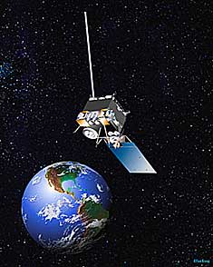
The GOES-R Satellite: A New Eye in the Sky

Slide 2
GOES Satellite “R” series
Under development since late 1990s
Next in progression of GOES satellite series
Replacing the GOES N/O/P (13/14/15) satellites as they end their scheduled orbital lifespan
ENORMOUS increase of data
Improvements in spatial, spectral, temporal and radiometric resolution of products
New technology for new products

Slide 3
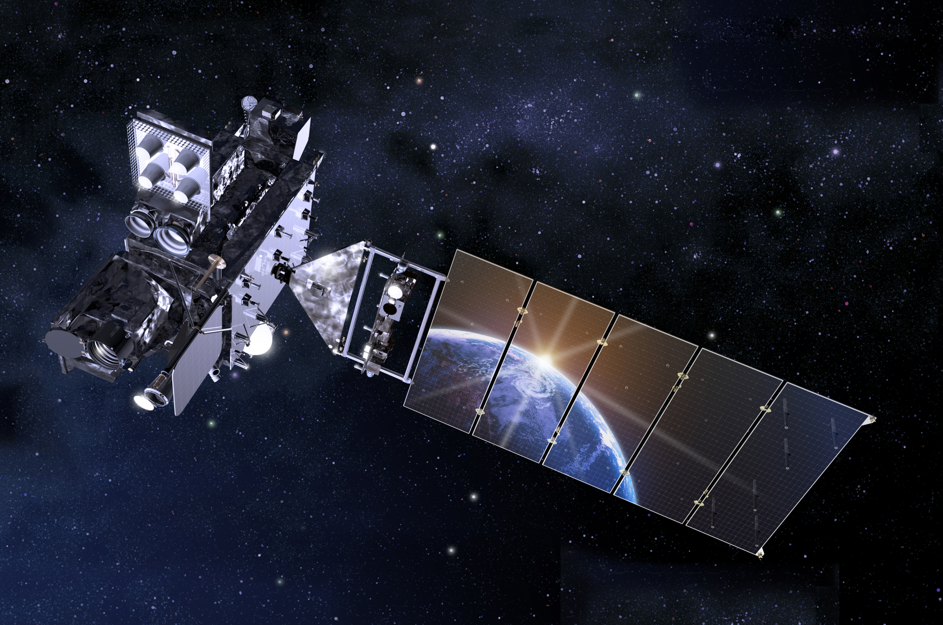
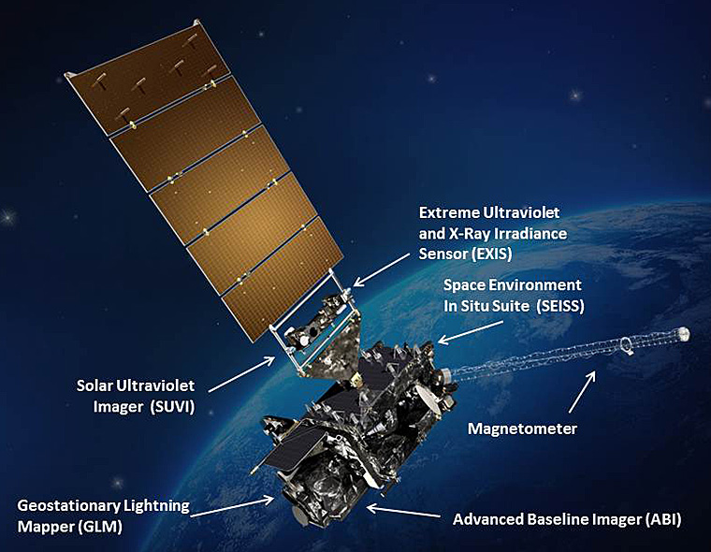

Slide 4
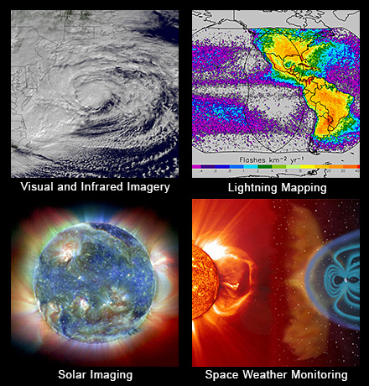

Slide 5
Continuity of GOES Operational Satellite Program
Scheduled Launch
January-March 2016

Slide 6
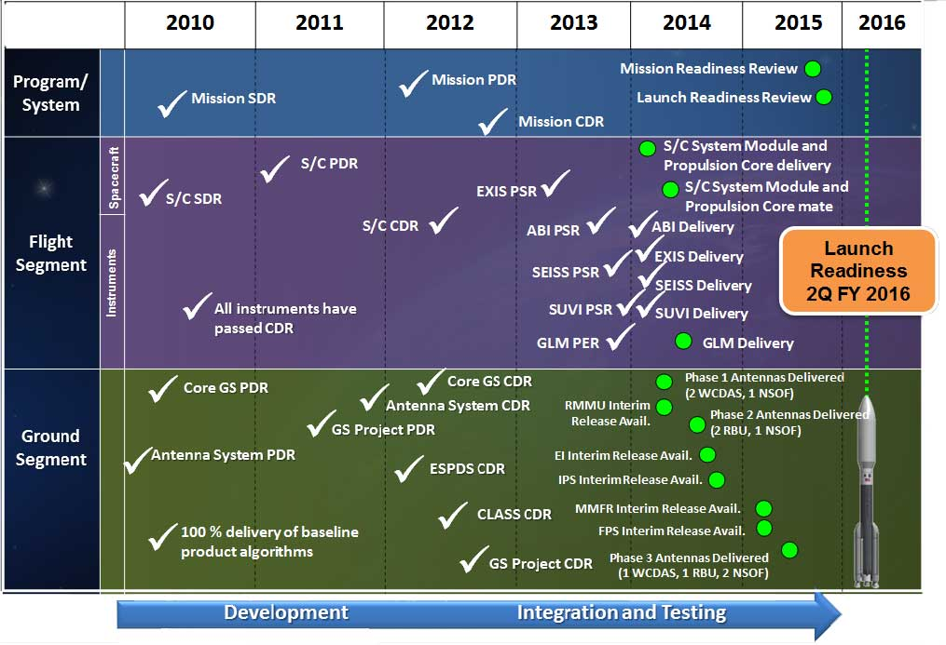
GOES-R Milestones

Slide 7
GOES-R Instruments

Slide 8
Advanced Baseline Imager (ABI)
16 Channel imager
2 visible, 4 near-IR and 10 IR channels
Improves upon current satellite capabilities
3 times spectral information
4 times spatial coverage
5 times temporal resolution
Continues current products
Allows for new products
Severe weather forecasting
Fire and smoke monitoring
Volcanic Ash Advisories
Visible and Infrared Imagery
Full Disk every 15 minutes
CONUS every 5 minutes
Rapid Scan every minute
Super Rapid Scan –
1000 km² every 30 seconds OR 2 areas per minute!

Slide 9
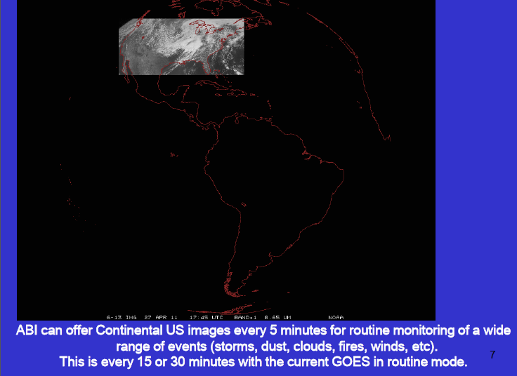

Slide 10
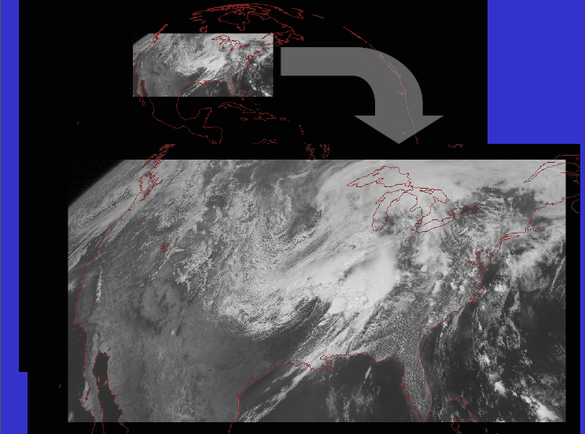

Slide 11
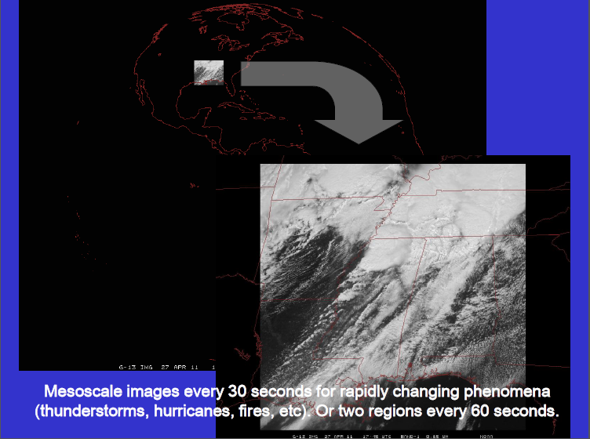

Slide 12
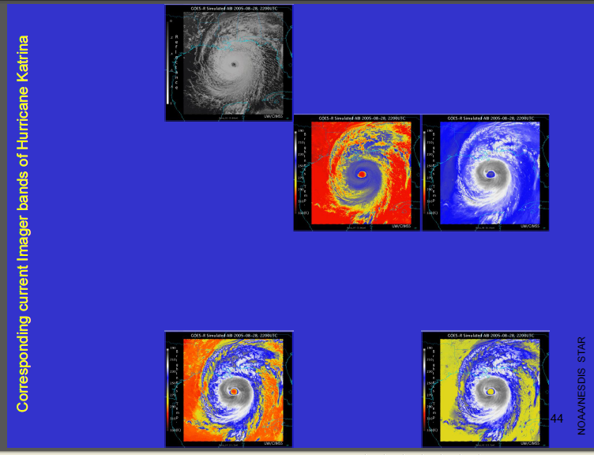

Slide 13
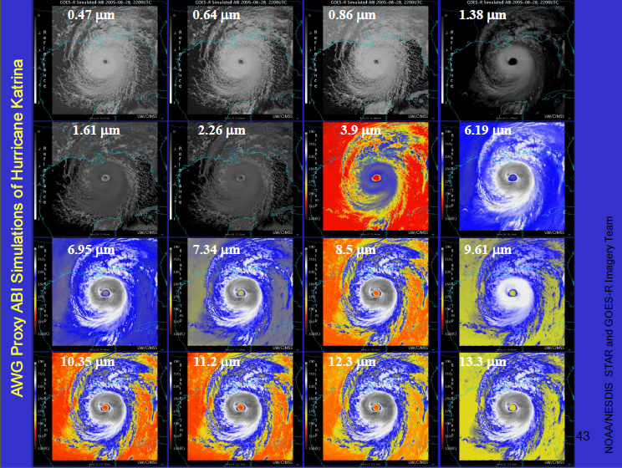

Slide 14
Progression of GOES Fog Products
Heritage GOES
Fog Detection
GOES-R Algorithm
applied to current GOES
GOES-R Algorithm Applied
to GOES-R **
** Using data from TERRA,
AQUA and GOES, part of
GOES-R Proving Ground

Slide 15
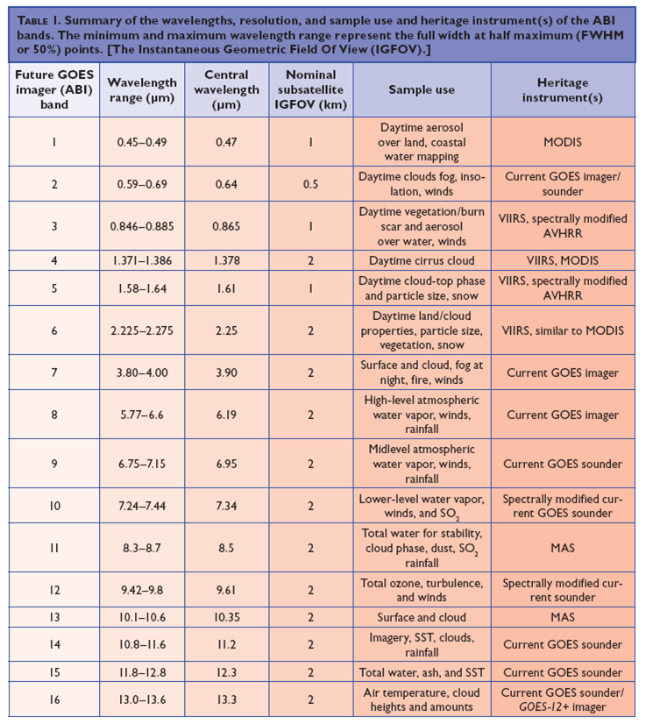

Slide 16
GOES-R Products
Sample Baseline Products
Future Capability Products
Aerosols
Clouds and Moisture Imagery
Fire Detection & Characterization (FDC)
Hurricane Intensity Estimation
Hydrology
Snow Cover
Volcanic Ash: Detection & Height
Aircraft Icing Threat
Enhanced-V & Overshooting Top Estimation
Flood/Standing Water
Fog/Low Cloud Detection
Turbulence
Visibility
http://www.goes-r.gov/products/ list.html

Slide 18
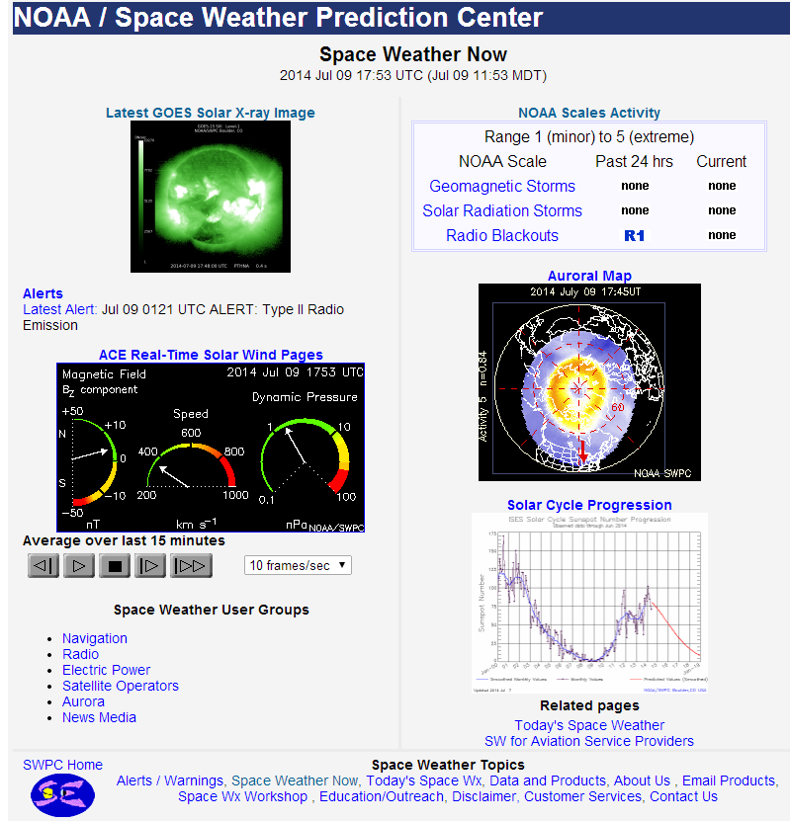
www.swpc.noaa.gov

Slide 19
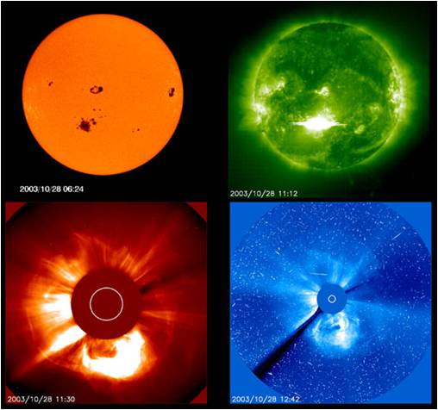
GOES-R Space Weather
Space Environment In-Situ Suite (SEISS)
Ensemble of electron, proton and
heavy ion detection sensors
Critical information to assess
electrostatic discharge risk &
radiation hazard to astronauts
and satellites
Warn of high flux events,
mitigate any damage to radio
communication
Data will drive solar radiation
storm portion of NOAA Space
Weather Scales
Geomagnetic storms
Solar Radiation storms
Radio Blackouts
www.swpc.noaa.gov/NOAAscales

Slide 20
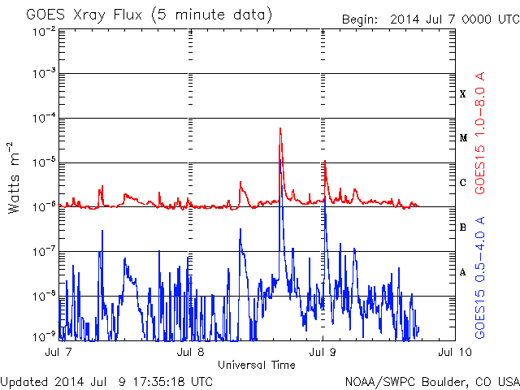
GOES-R Space Weather
Extreme UV/X-ray Irradiance Sensor (EXIS)
Solar X-ray irradiance (XRS) & Solar Extreme UV (EUVS) spectral irradiance in 5-127 nm range
Issue warnings based on
solar x-ray increases, large
spikes from solar flares
Warnings for radio
blackouts of terrestrial HF
radio communications at
low latitudes
Potential hazards to
astronauts in orbit, decrease
in optimal life of satellites
(degradation of solar panels)
Current SWPC Irradiance product
New capabilities expected with new
data from GOES-R

Slide 21
GOES-R Space Weather
Solar UV Imager (SUVI)
Locates coronal holes, flares and coronal mass ejection source regions
Characterizes active region complexity
Improves forecasting of space weather and early warnings of possible Earth environmental impacts
Magnetometer
Measures time-varying field in magnetosphere
Provides only operational measure of impact of geomagnetic storms at geosynchronous orbit
Key in interpreting solar radiation storm measurements by SEISS

Slide 22
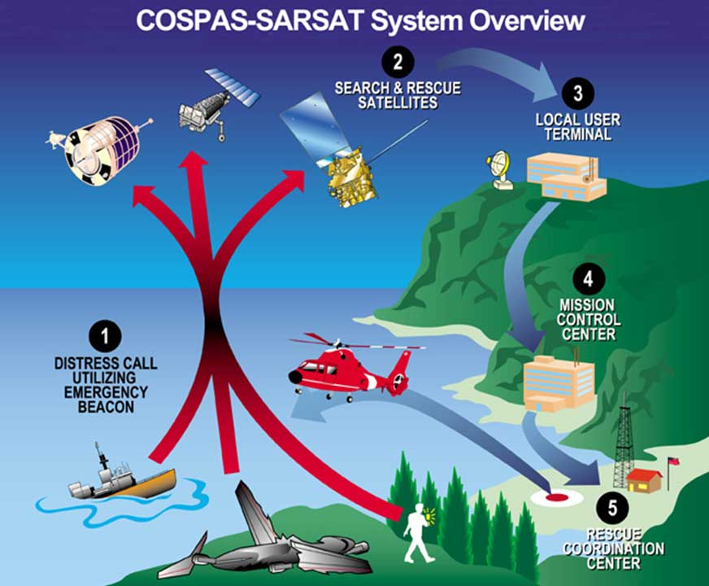

Slide 24
www.goes-r.gov/users/proving-ground

Slide 26
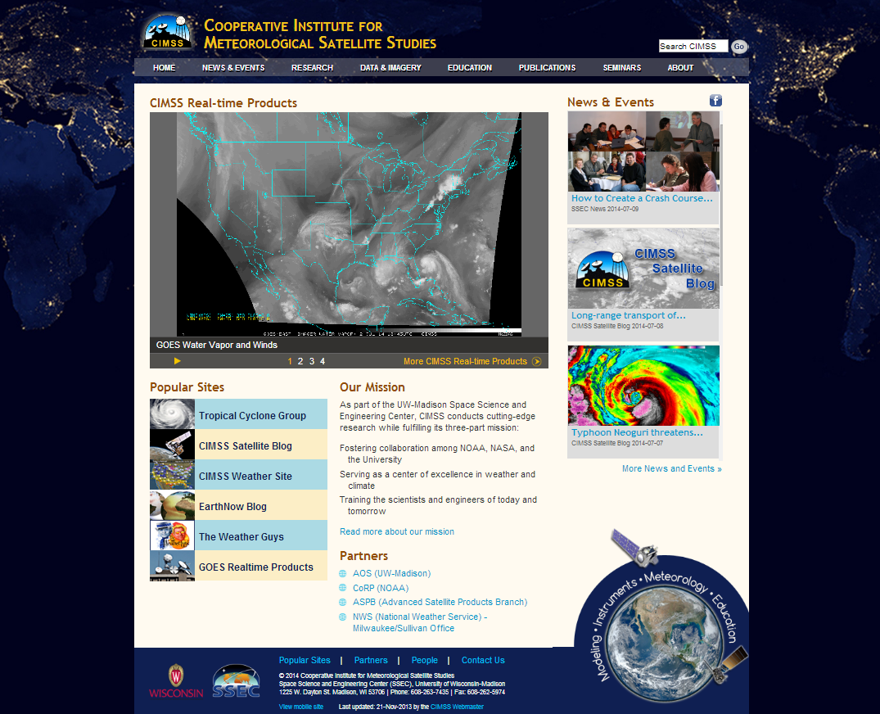

Slide 28
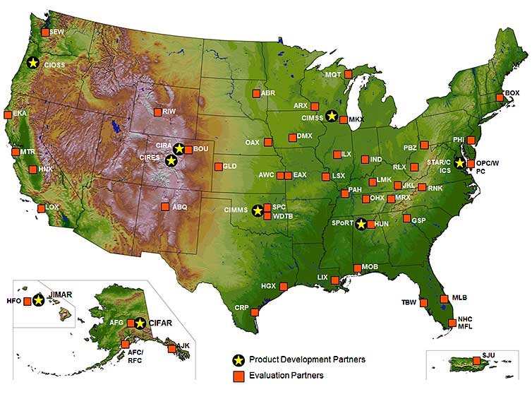
Formal GOES-R Proving Ground Partners
May 2014

Slide 30
http://cimss.ssec.wisc.edu/goes_r/proving-ground.html

Slide 31
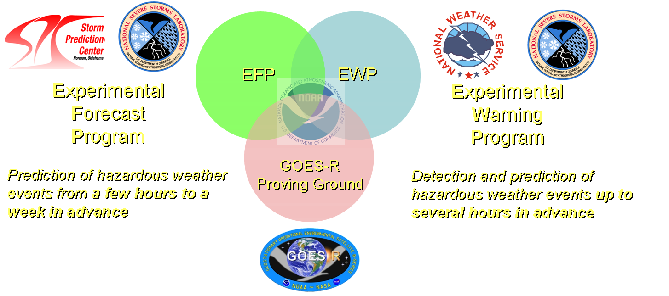
NOAA’s Hazardous Weather Testbed
Not just a facility…
…but an organization

Slide 35
Testbed Takeaways – 2014
Almost ready for operations
ProbSevere
Trends on target
Struggles with mature cells
NearCast
Predicted area of convective instability well
Possibly add an interpolation toggle ability to fill gaps in with NWP
Notes:
35

Slide 36
Testbed Takeaways – 2014
Get this to my office “yesterday”!
Lightning Flashes & Lightning Jump Algorithm
Increases confidence in severity of storms
Provided information about updraft health
Super-Rapid Scan Operations (SRSOR) Imagery
Used to observe key storm-scale features; 1-min temporal resolution made this possible
Simulated Satellite Imagery
Comparison to reality raised or lowered confidence in using model
When on-track, predicted areas of storm development
Notes:
36

Slide 38
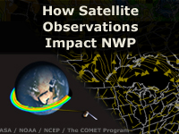
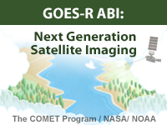
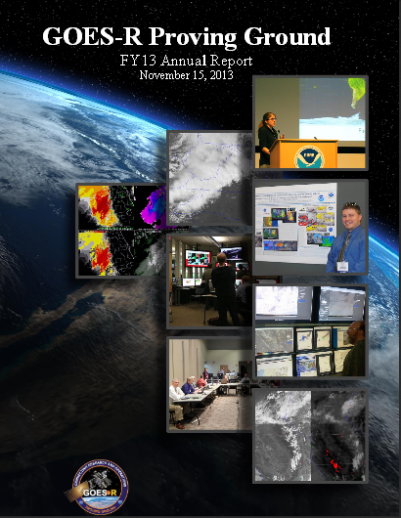
Training and Education Materials
New!
Online Training Modules
How Satellite Observations Impact NWP
GOES-R ABI: Next Generation Satellite Imaging (COMET)
GOES-R: Benefits of Next-Generation Environmental Monitoring (COMET)
Satellite Hydrology and Meteorology for Forecasters (SHyMet)
SPoRT product training modules
VISIT Training Resources
Commerce Learning Center
Printed Materials
GOES-R Fact Sheets (18)
User Readiness Plan
GRB Downlink Specifications and Product Users Guide
Proving Ground Demonstration Final Reports and Annual Reports
Notes:
GOES-R: Benefits of Next Generation Environmental Monitoring - Includes an overview of the mission, instruments, system and services, satellite synergy, the role of GOES-R in the Global Observing System as well an environmental monitoring section that addresses the benefits of GOES-R and the ability to monitor 13 unique hazards and phenomena.
GOES-R 101 - Targeted for Forecasters and anyone else interested in basic aspects of GOES-R
Satellite Hydrology and Meteorology (SHyMeT) - Dedicated to operational satellite meteorology. The Forecaster track of the SHyMet course covers satellite imagery interpretation, including feature identification, water vapor channels, and what to expect on GOES-R. There is a session on remote sensing data for operational hydrology as well as one relating to aviation hazards. Other topics include an understanding of the Dvorak method in tropical cyclone analysis and the utility of cloud composites in forecasting
CIMSS Satellite Meteorology for Grades 7-12 -Meteorology is an excellent topic to introduce middle and high school students to geoscience, physics, chemistry, and applied mathematics. Satellite Meteorology provides scientists and educators with exciting tools for investigation, inquiry, analysis and stewardship.
Commerce Learning Center: Forecasters can take these training courses and get credit for taking them

Slide 39
Also Available:
Student Resources
“Fun and Games”
http://www.goes-r.gov/education/outreach.html

Slide 40
